Slide 1
DANNY DINNER
PRESENTED BY
Nguyen Ba Tin

Slide 2
INTRODUCTION
Danny loves Japanese food so in the beginning of 2021, he decides to open up a cute little restaurant that sells his 3 favourite foods: sushi, curry and ramen.
The restaurant has captured some very basic data from their first months of operation but they have no idea how to use their data to help them run the business.

Slide 3
PROBLEM STATEMENT
Danny wants to use the data to answer a few simple questions such as their visiting patterns, how much money they’ve spent and also which menu items are their favourite.
He plans on using these insights to help him decide whether he should expand the existing customer loyalty program

Slide 4
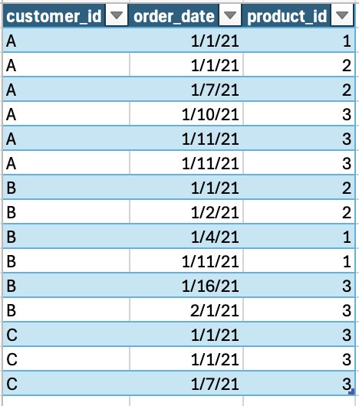
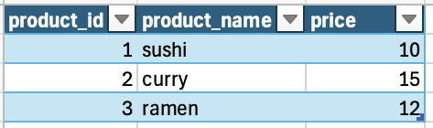
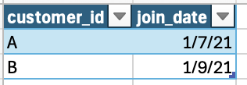
About Dataset
Table 1: Sales
Table 2: Menu
Table 3: Members

Slide 5
SALE PERFORMANCE

Slide 6
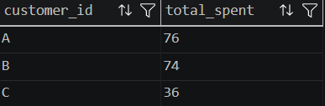
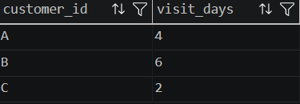
Q1, Q2: What is the total amount each customer spent at the restaurant? and How many days has each customer visited the restaurant?
-- 1
SELECT s.customer_id,
SUM(m.price) AS total_spent
FROM sales s
JOIN menu m
ON s.product_id = m.product_id
GROUP BY s.customer_id;
-- 2
SELECT s.customer_id,
COUNT(DISTINCT s.order_date) AS visit_days
FROM sales s
GROUP BY s.customer_id;

Slide 7
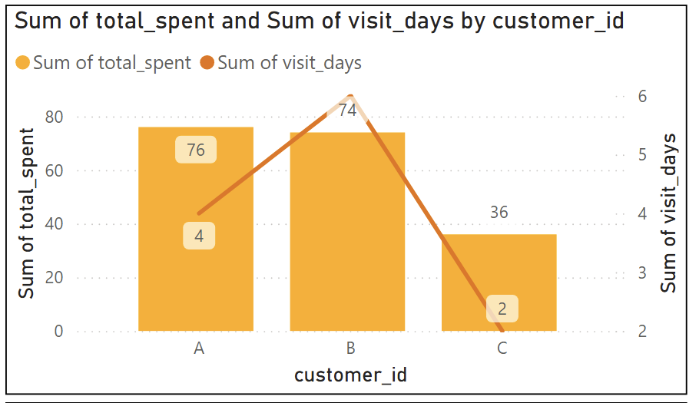
Customer A: Highest spender ($76).
Customer B: Most frequent visitor (6 times).
Customer C: Lowest spender ($36), still in the "trial" stage.

Slide 8
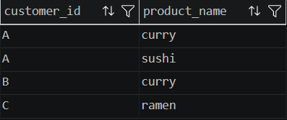
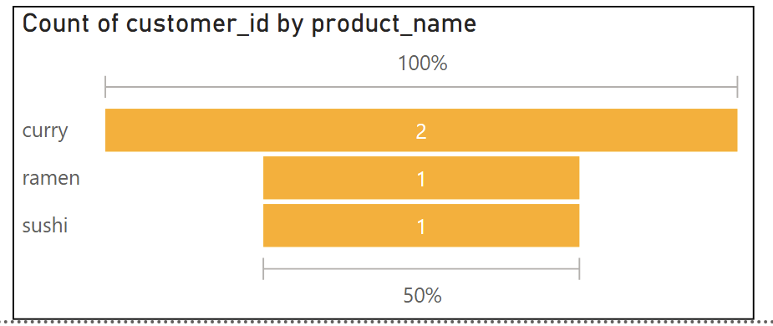
Q3. What was the first item from the menu purchased by each customer?
-- 3
SELECT DISTINCT s.customer_id, m.product_name
FROM sales s
JOIN menu m
ON s.product_id = m.product_id
WHERE s.order_date =
(SELECT MIN(s2.order_date)
FROM sales s2
WHERE s2.customer_id = s.customer_id);
Curry is the first item that attracts customers when they come to the restaurant followed by Ramen and Sushi

Slide 9

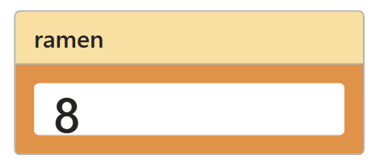
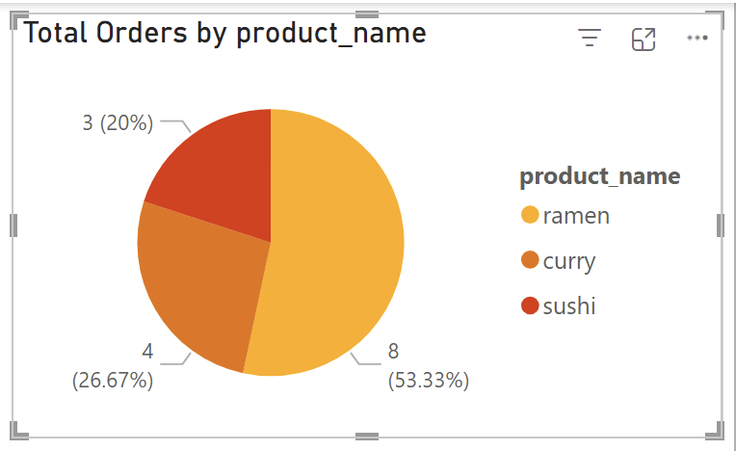
Q4. What is the most purchased item on the menu and how many times was it purchased by all customers?
-- 4
SELECT TOP 1
m.product_name, COUNT(s.product_id) AS total_orders
FROM sales s
JOIN menu m
ON s.product_id = m.product_id
GROUP BY m.product_name
ORDER BY total_orders DESC;
Ramen is the most popular dish in the restaurant, and the primary reason customers return.

Slide 10
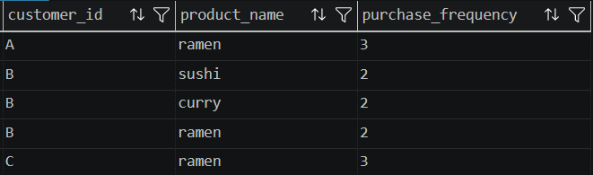
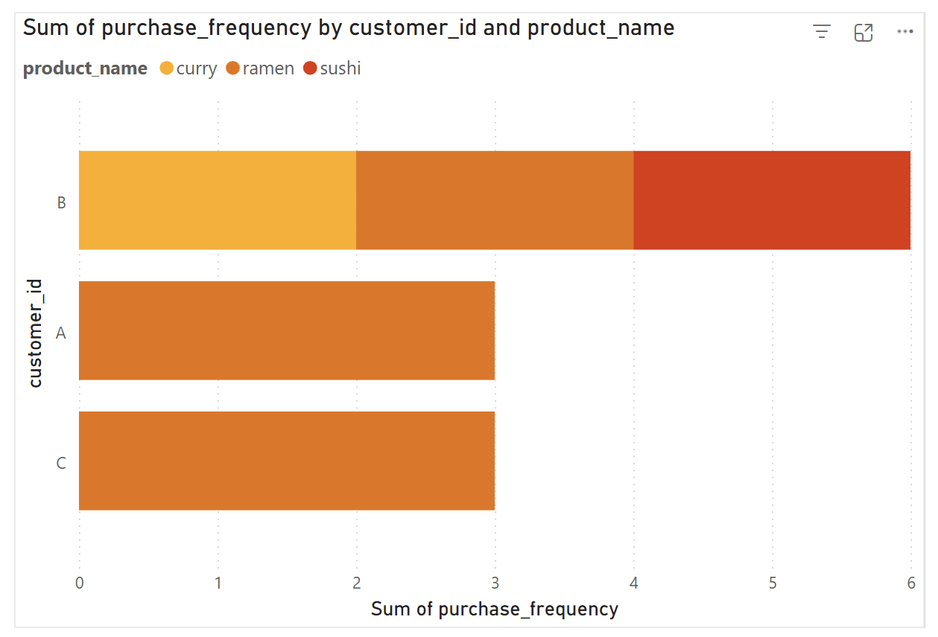
Q5. Which item was the most popular for each customer?
--5
with freqrank as (
Select
s.customer_id, s.product_id,
count(s.product_id) as purchase_frequency,
dense_rank() over
(partition by s.customer_id order by count(s.customer_id) desc) as rnk
from sales s
group by s.customer_id, s.product_id)
select
f.customer_id,
m.product_name,
f.purchase_frequency
from freqrank f
join menu m on f.product_id = m.product_id
where f.rnk = 1
order by f.customer_id;
A & C stay loyal to Ramen only, while B explores the entire menu.

Slide 11
Key Insights
A & C stay loyal to Ramen only, while B explores the entire menu.

Slide 12
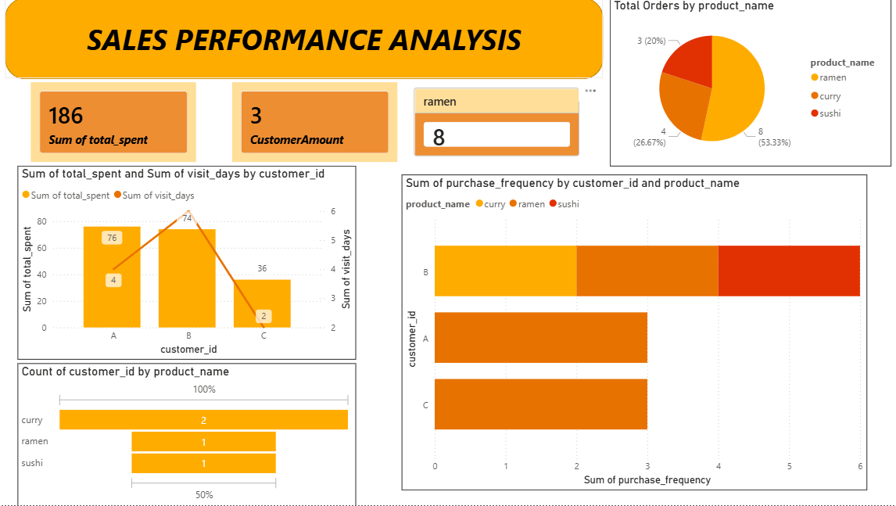
Consider having different strategies for each customer group: A is the "Big Spender," B is the "Loyal Visitor."
Consider using “Curry” visuals in new customer acquisition ads.
Ramen is a best-seller, so ensuring consistent ramen quality is crucial, as it can become the signature dish that defines the brand.

Slide 13
CUSTOMER LOYALTY BEHAVIOR

Slide 14

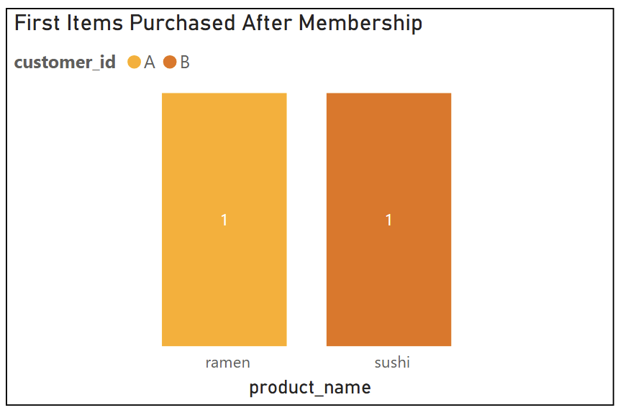
Q6. Which item was purchased first by the customer after they became a member?
-- 6
with orders as
(
Select s.customer_id, m.product_name, s.order_date, mb.join_date,
dense_rank() over
(partition by s.customer_id order by s.order_date) as rnk
from menu m
join sales s on m.product_id = s.product_id
join members mb on s.customer_id = mb.customer_id
where s.order_date > mb.join_date)
select customer_id, product_name, order_date
from orders o
where rnk = 1;
Ramen and sushi are the first dishes customers choose after joining the membership.

Slide 15
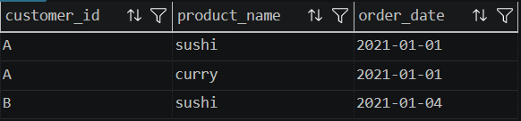
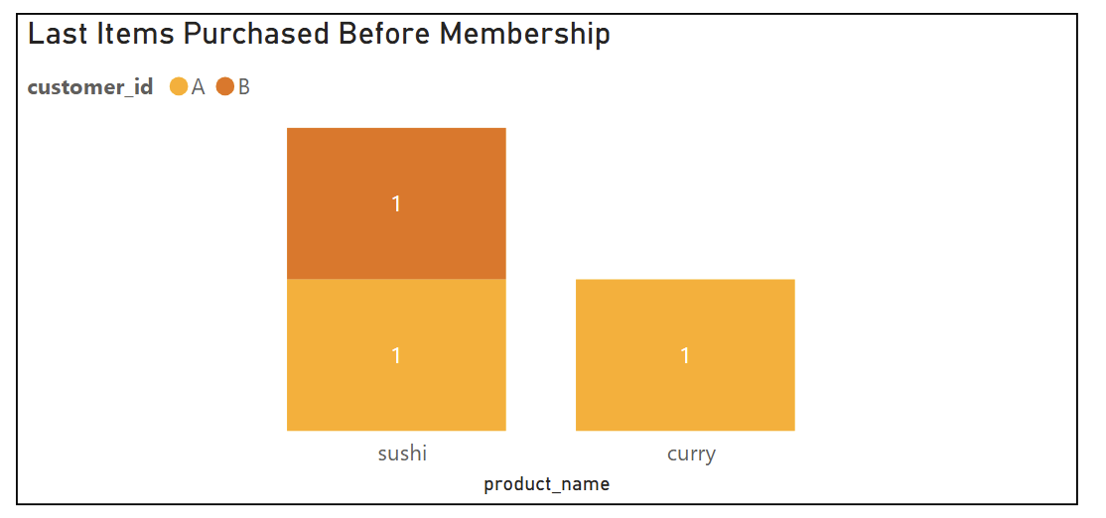
Q7. Which item was purchased just before the customer became a member?
-- 7
with orders as
(
Select s.customer_id, m.product_name, s.order_date, mb.join_date,
dense_rank() over
(partition by s.customer_id order by s.order_date desc) as rnk
from menu m
join sales s on m.product_id = s.product_id
join members mb on s.customer_id = mb.customer_id
where s.order_date < mb.join_date
)
select customer_id, product_name, order_date
from orders o
where rnk = 1;
Sushi and Curry are the last items purchased before joining the membership

Slide 16

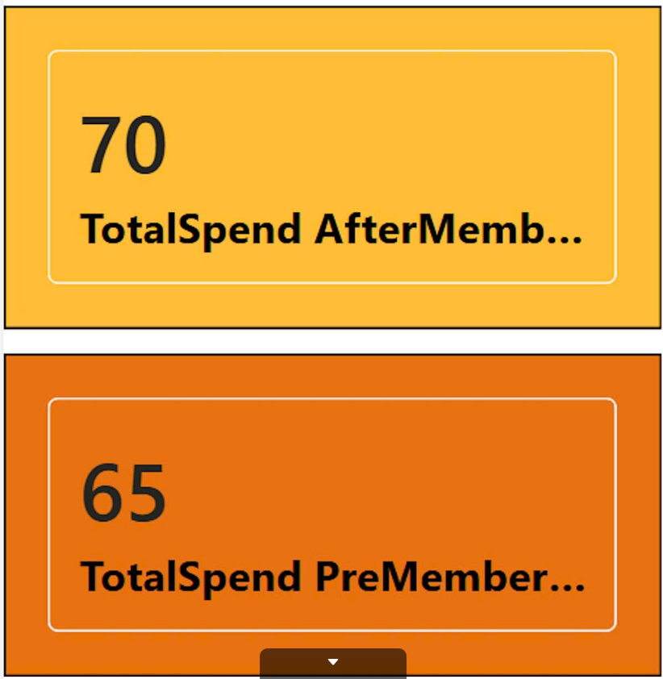
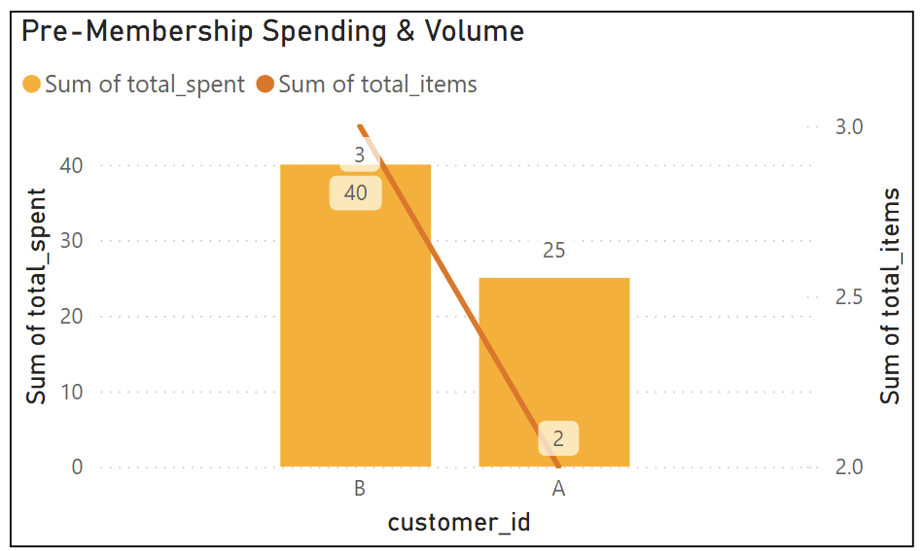
Q8. What is the total items and amount spent for each member before they became a member?
-- 8
select s.customer_id,
count(s.product_id) as total_items,
sum(m.price) as total_spent
from menu m
join sales s on m.product_id = s.product_id
join members mb on s.customer_id = mb.customer_id
where s.order_date < mb.join_date
group by s.customer_id;
Customer B spends more ($40 vs $25) and buys more items (3 vs 2 items) than Customer A before becoming a member.
Customers show higher engagement (Revenue increase) after joining the membership program

Slide 17
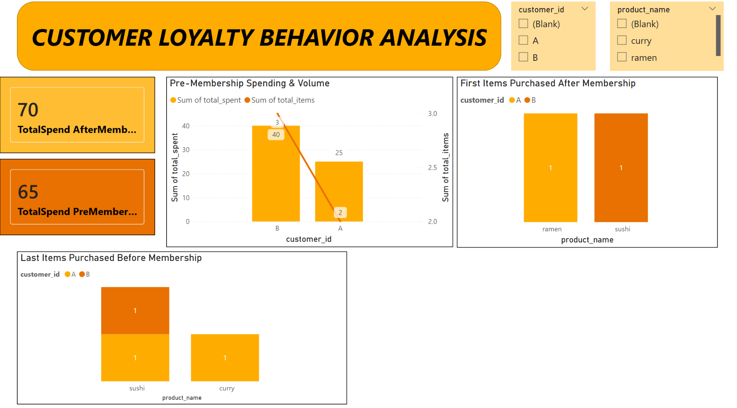
Customers tend to spend more and return more when they joining membership program
=> Continue to maintain and develop membership programs to trigger new customers and retain existing customers.

Slide 18
REWARDS & POINTS

Slide 19
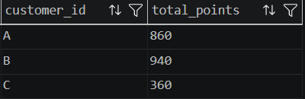
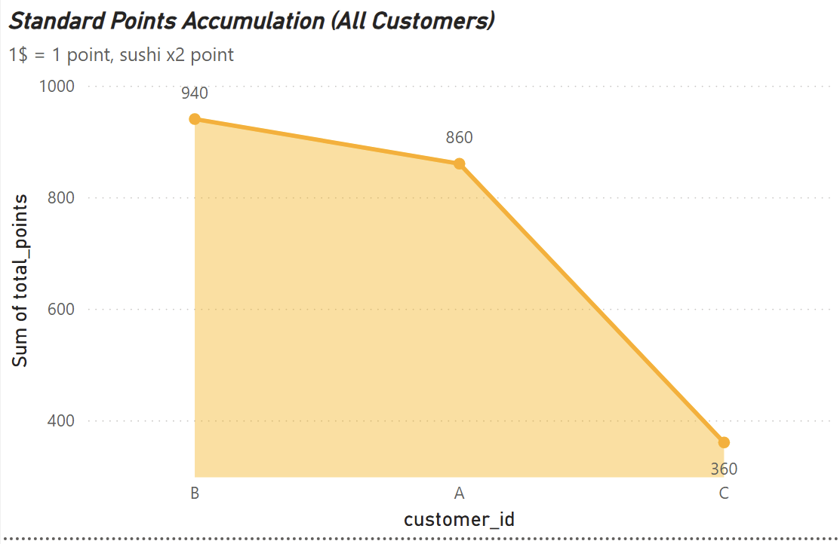
Q9. If each $1 spent equates to 10 points and sushi has a 2x points multiplier - how many points would each customer have?
-- 9
with customer_points as
( select s.customer_id, case
when m.product_name = 'sushi' then m.price*20
else m.price*10
end as points
from sales s
join menu m on m.product_id = s.product_id
)
select cp.customer_id,
sum(points) as total_points from customer_points cp
GROUP by cp.customer_id;
Customer B leads in points thanks to their strategy of eating sushi (the only dish that earns double points).

Slide 20
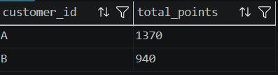
Q10. In the first week after a customer joins the program (including their join date) they earn 2x points on all items, not just sushi - how many points do customer A and B have at the end of January?
-- 10
with customer_point_january AS
(
select s.customer_id, m.product_name, m.price, s.order_date, mb.join_date,
case
when s.order_date between mb.join_date and DATEADD(day,7, mb.join_date) then m.price*20
when m.product_name ='sushi' then m.price*20
else m.price*10
end as points
from menu m
join sales s
on m.product_id = s.product_id
join members mb
on s.customer_id = mb.customer_id
where s.order_date < '2021-02-01'
)
select customer_id,
SUM(points) as total_points from customer_point_january
group by customer_id;

Slide 21
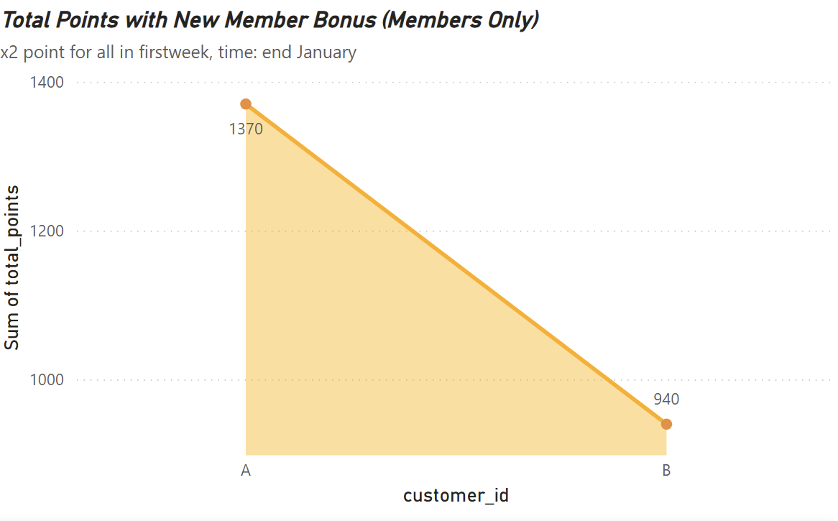
Customer A takes advantage of “First Week” increasing their total points by 60% in just a few days.

Slide 22
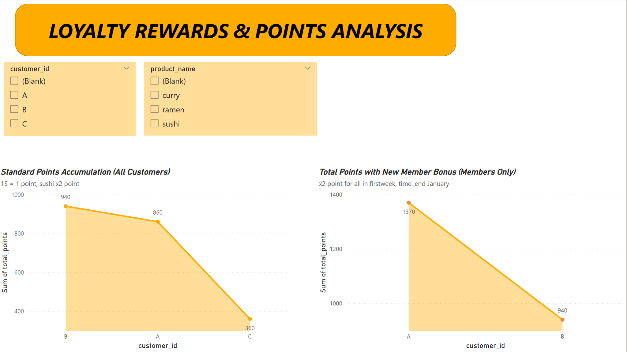
Monthly Performance: As of January 31st, 2021, Customer A has leveraged the new member bonus to lead with 1,370 points.
Early Success: The double-point promotion in the first week of membership was the primary driver for the high engagement levels seen in January.
Next Steps: We should monitor if this momentum continues into February or if customers only "hunt" for points during the initial promo period.

Slide 23

Conclusions & Recommendations
YES: WE SHOULD EXPAND THE LOYALTY PROGRAM
Menu Optimization
Leveraging customer behavior to drive conversion:
Acquisition (Curry): The primary "hook" for new customers.
Retention (Ramen): The core signature dish (50%+ of total volume).
Profitability (Sushi): Drives premium spending via the 2x point multiplier.
Member Performance
Analyzing the impact of the loyalty system:
Spending Lift: Average transaction value rose from $65 to $70 post-membership.
Engagement: The "First Week 2x Bonus" significantly increased visit frequency.
Loyalty Value: Customers A & B represent 80% of identified total revenue.
Action Roadmap
Next steps for business scaling and growth:
Segmented Marketing: Use Curry for ads; customize rewards for high-spenders vs. frequent visitors.
Loyalty Scaling: Expand the membership program to drive both new acquisition and repeat visits.
Sustainability Audit: Monitor February data to ensure long-term engagement beyond the initial promo period.

Slide 24
Thank For Listening

